Slide 1
What Is ‘Function as a Service’?
Overview
Monolithic
Serverless
Replaces formal applications that typically rely on servers with a serverless function
Client (Browser)
Client (Browser)
Each function has multiple stateless instances of itself, based on the number of times it is triggered (event-driven)
API Gateway
Server
Scales functions up and down efficiently with no tradeoff in processing power
Function
Function
Modularizes always-running server architectures into short-lived segments of runnable code
Database(s)
Database(s)

Slide 2



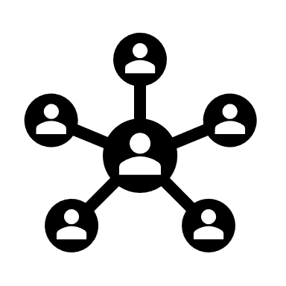

When Should I Use FaaS?
APIs
Heavy Traffic
Batch Processing
Display Function
Click Function
Function Instances
App Servers
File Servers
API Gateway
Server or Gateway
Batch Function
Client
Clients
Timer Trigger
In general, FaaS is most useful for managing high-volume workloads and backend microservices that can essentially be ‘outsourced’ from the original architecture of an app. Some other examples include chatbots, machine learning models, and data parsing.

Slide 3






Which FaaS Type Suits Best?
Cloud Provided
On-Premise (Pre-Cloud)
AWS Lambda
Azure Functions
Knative
OpenFaaS
Task
3rd party managed
Personally managed
Func
Events
Only pay for what you use
Pay for your own hardware/servers
Search Function
Func
Events
Task
Abstracts away architectural processes
Design & efficiency depends on provider
Search Function
Base Application
Base Application
Less oversight, less troubleshooting
More direct input, higher managing costs

Slide 4





FaaS On-Premise Framework Overview
Knative*
OpenFaaS
Kubeless
Fission
OpenWhisk
Fn Project
Developer(s)
Google & Pivotal
VMware
Bitnami
Platform9
Apache
Oracle
Software License
CCA 4.0
MIT
Apache 2.0
Apache 2.0
Apache 2.0
Apache 2.0
GitHub Ratings
3,800
17,800
5,800
5,200
4,800
4,600
Active Development**
1,645
109
62
27
91
0
Kubernetes Support
Container Support
--------
Multitenancy
--------
--------
Full Scalability
No scale to zero
Limited scale up
Native User Interface
--------
--------
--------
Built-In Auth Security
--------
--------
--------
* Knative and the other platforms cannot be easily compared directly, as Knative provides different functionality and can be used together with other frameworks.
** Measured by the number of GitHub commits of the main platform files starting from January 1st, 2020 up until June 15th, 2020.
Notes:
Sources:
https://medium.com/appvia/serverless-on-kubernetes-63b49aeaf4ef
https://vshn.ch/en/blog/a-very-quick-comparison-of-kubernetes-serverless-frameworks/
https://epsagon.com/blog/serverless-open-source-frameworks-openfaas-knative-more/

Slide 5
FaaS Framework Further Comparison
Knative*
OpenFaaS
Kubeless
Fission
OpenWhisk
Fn Project
Supported Languages
Any language supported by container images*
Node, Java, Python, Ruby, C#, PHP, Go, and extra templates
Node, Java, Python, Ruby, C#, PHP, Go, Ballerina, custom
Node, Java, Python, Go, custom ENVs
Node, Java, Scala, Rust, Python, Ruby, C#, PHP, Go, Ballerina, Swift, custom RTs
Node, Java, Python, Ruby, C#, Go, and custom images
Function Deployment
Knative Serving Component
REST API, UI, CLI, or Function Store
function deploy with CLI
fn create with CLI
action create with CLI and wskdeploy binary
init and deploy with CLI
Function Triggers
Custom Brokers and Triggers based on CloudEvents
HTTP, Async, CLI, any event connector (i.e. Kafka, Cron, etc)
HTTP, CronJob, Kafka, NATS, AWS Kinesis
HTTP, Timer, Kafka, NATS, K8s Watch
HTTP, Message Queues, Databases, IoT Framework, Service API, Web Apps, etc.
HTTP
Logging and Monitoring**
Elasticsearch, Stackdriver, Grafana, or plugins
Gateway metrics, Grafana, Watchdog
Prometheus or Grafana
Web UI from IBM Cloud or CLI activation record
Prometheus, Grafana, Fn UI
Prometheus
Documented Processes
Setup, K8s clusters, serving & eventing, samples
Setup, K8s integration, CLI features, architecture
Setup, CLI features, architecture, troubleshooting
Setup, CLI, architecture, troubleshooting
Setup, some CLI features, architecture, sample code, add-on tools, debugging
Setup, language-specific CLI usage, samples, debugging
* While other frameworks have built-in support in their platforms for certain languages and custom runtime options, Knative uses containers as the deployment unit itself.
** Prometheus, Grafana, etc. are monitoring tools that have their own displays, each with different metrics that can be added and customized by user preference.

Slide 6



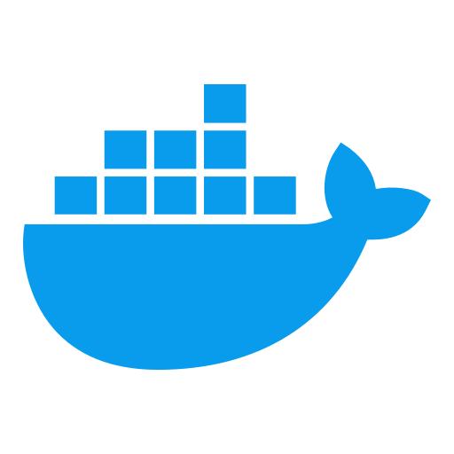



Architecture Diagram: OpenFaaS
UI/Server
FaaS Provider: Kubernetes
Secrets
Deployment
Service
OpenFaaS Operator
OpenFaaS Gateway
Alert Manger: Scale Up/Down
Watchdog
Process
Docker Image: Function A
Prometheus Metrics
Function A

Slide 7
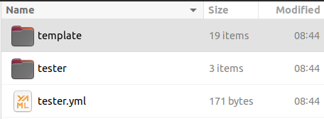
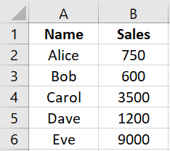
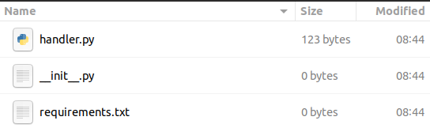
OpenFaaS Sample: Spreadsheet Parser Function
Objective
Function Build
Deploy a simple function that analyzes a spreadsheet and returns the highest sales value among all named employees
Sample Data
Directory structure of an OpenFaaS function
Internal components of the function
Notes:
For full documentation of the framework’s processes, check out: OpenFaas Cookbook.docx

Slide 8
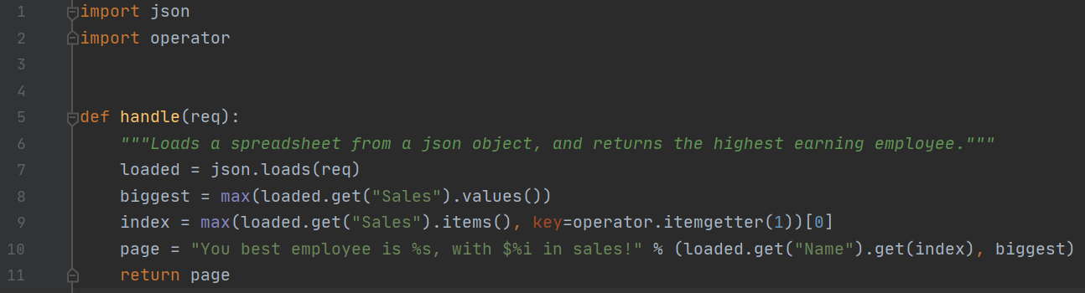
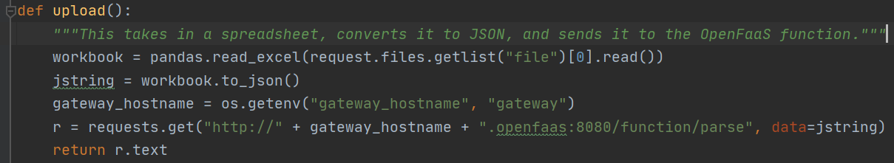
OpenFaaS Sample: Python Code
Function Handler
The test function is sealed in a file away from the main application. It is treated as a completely separate module to be called on later with a configured trigger.
Function Trigger
The trigger is within the application, replacing where the function would normally be located. It is invoked through an HTTP call, creating an instance of the function.

Slide 9
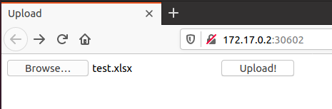
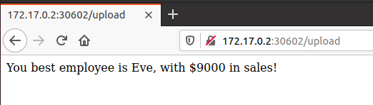
Invoking the Function
Behind The Scenes Processes
1
Function request sent from server to gateway
2
“Watchdog” initializes and monitors function
3
OpenFaaS scales function using Kubernetes
4
Function state(s) shut down after some time

